Slide 1

WELCOME TO
EEE 4203: Electronics I
Md. Sayed Hasan Rifat
Lecturer, EEE

Slide 2

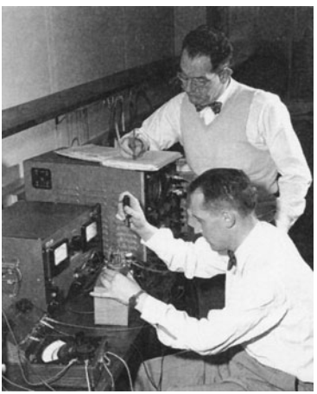
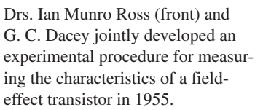
Early development of FET
Field Effect Transistor

Slide 3
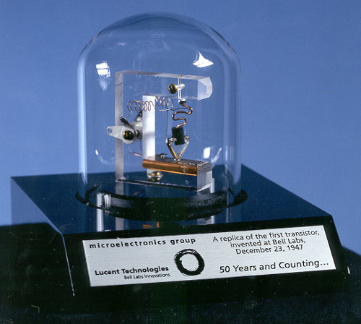
Early development of FET
Field Effect Transistor

Slide 4
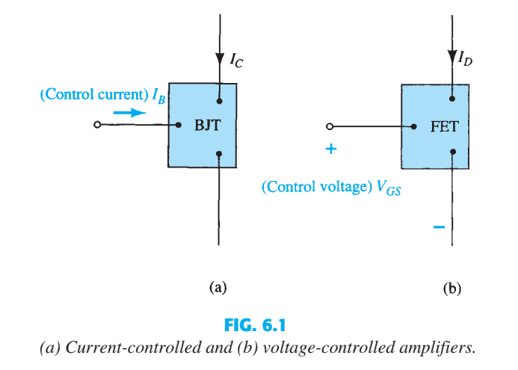
Differences between BJT and FET
Field Effect Transistor

Slide 5
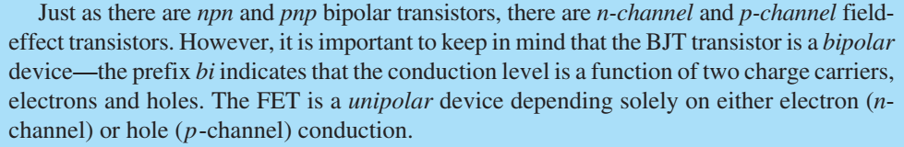
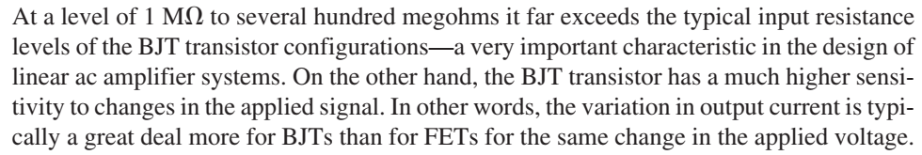
Differences between BJT and FET
Field Effect Transistor

Slide 6
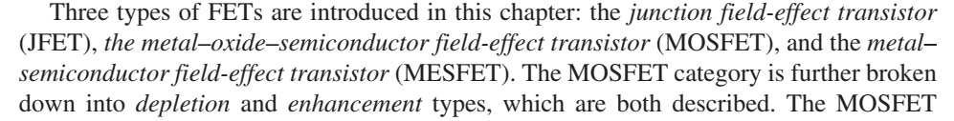
Differences between BJT and FET
Field Effect Transistor

Slide 7
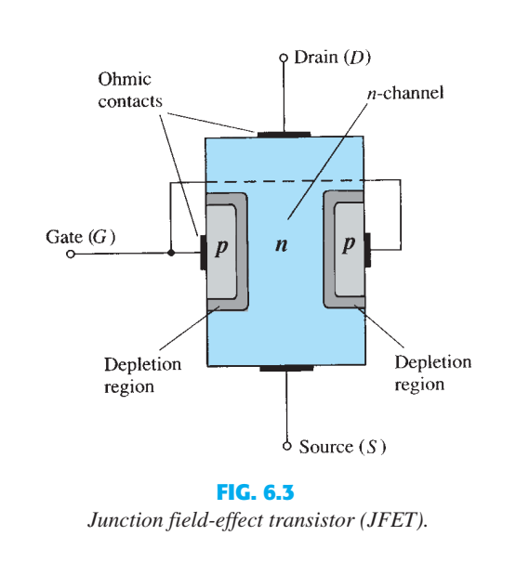
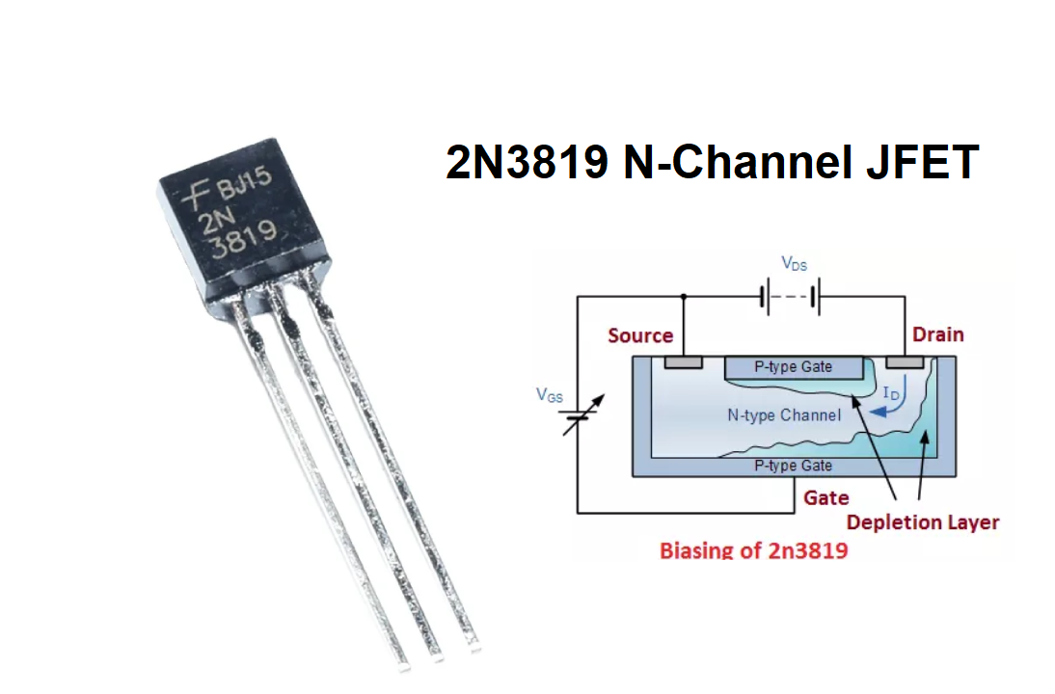
Construction of JFET
Field Effect Transistor

Slide 8
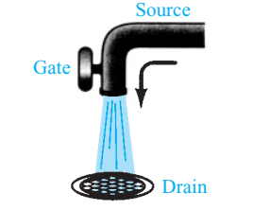
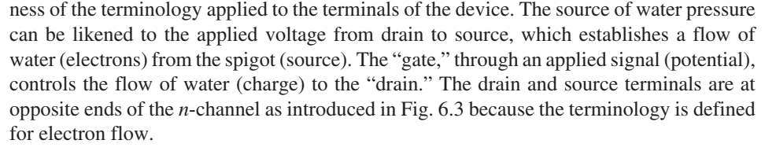
Construction of JFET
Field Effect Transistor

Slide 9
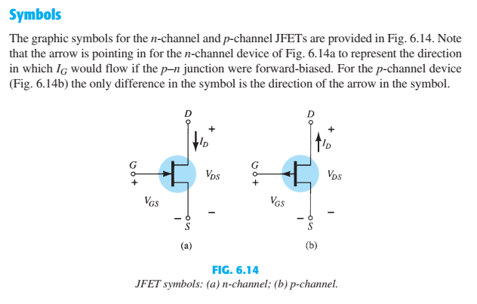
Construction of JFET
Field Effect Transistor

Slide 10

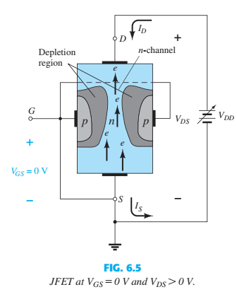
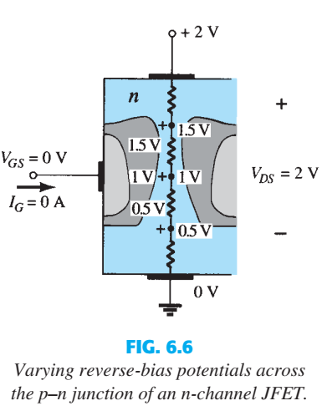
Working Principle of JFET
Field Effect Transistor

Slide 11
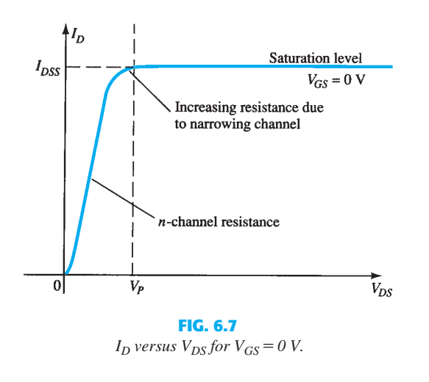
Field Effect Transistor

Slide 12
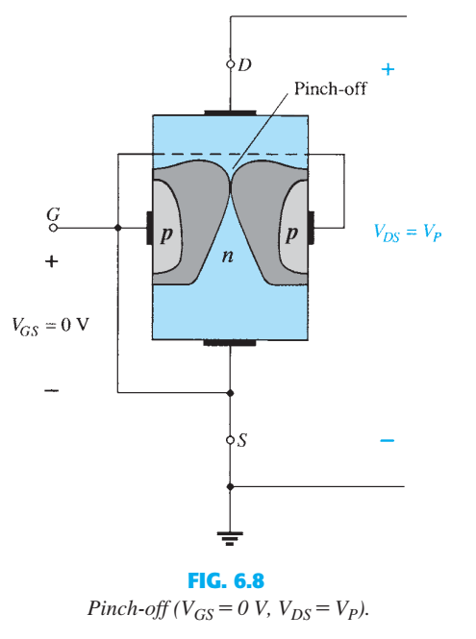
VGS=0, VDS=VP
Field Effect Transistor

Slide 13

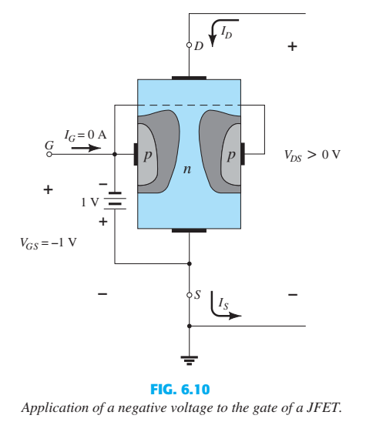
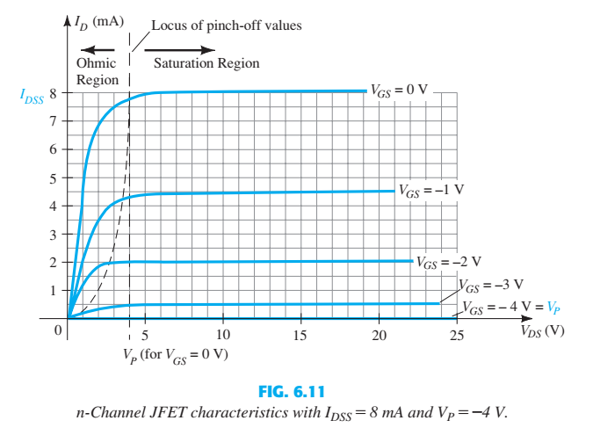
Field Effect Transistor

Slide 14
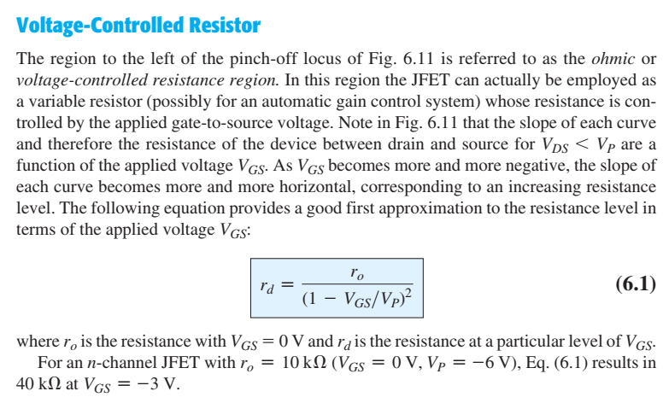
Field Effect Transistor

Slide 15

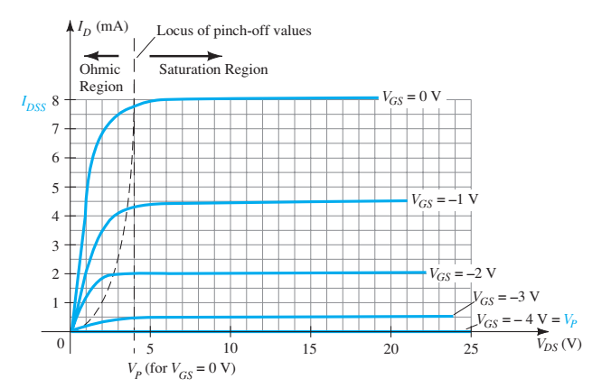
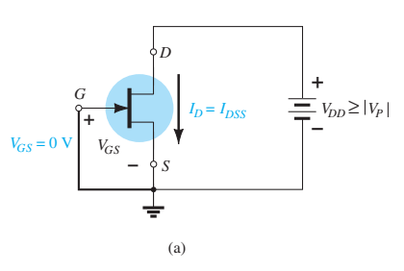
Field Effect Transistor

Slide 16
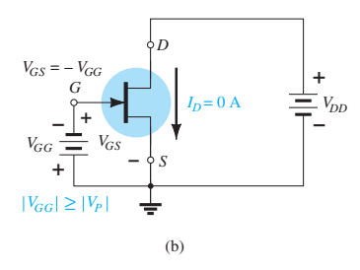
Field Effect Transistor

Slide 17
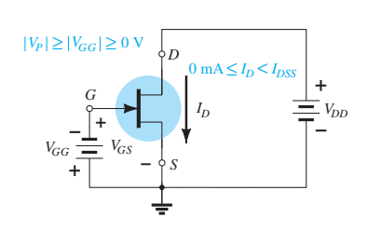
Field Effect Transistor

Slide 18
TASK (5 MARKS)
1. Draw the basic construction of a P-channel JFET.
2. For V_{GS}= 0V, briefly describe the working principle of P-channel JFET.
3. Apply proper biasing in the construction and show current flow direction.
4. Sketch the drain characteristics curve for different values of V_{GS}.
Field Effect Transistor

Slide 19
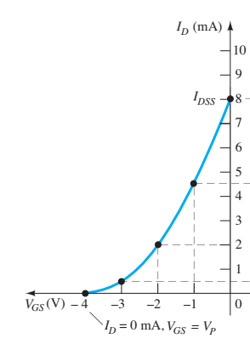
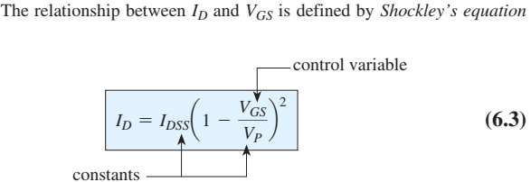
Field Effect Transistor

Slide 20
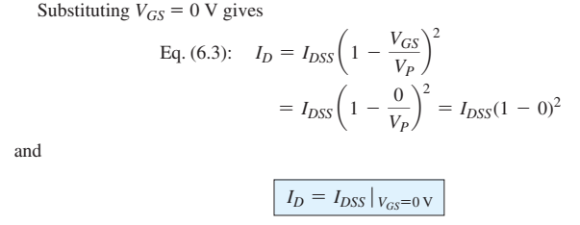
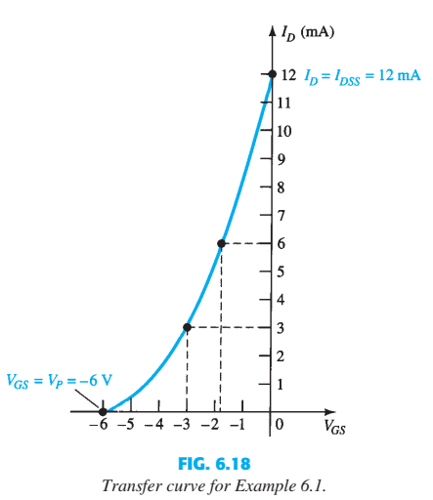
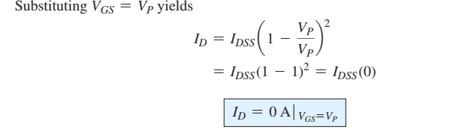
Field Effect Transistor

Slide 21
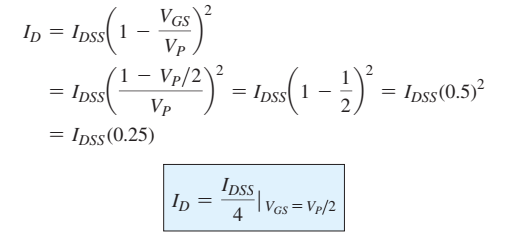
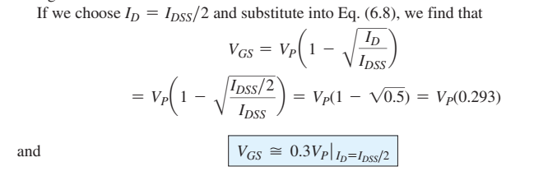
Field Effect Transistor

Slide 22
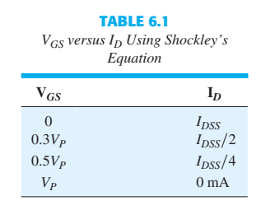
Field Effect Transistor

Slide 23
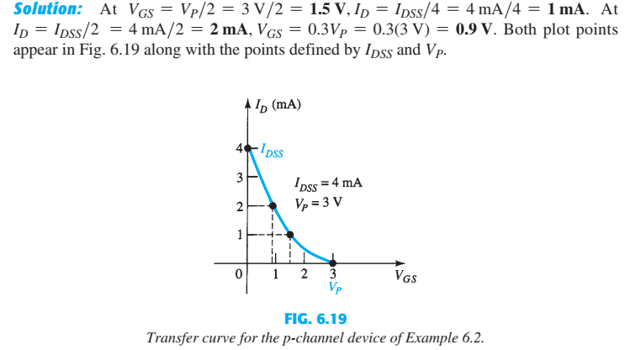
Field Effect Transistor

Slide 24

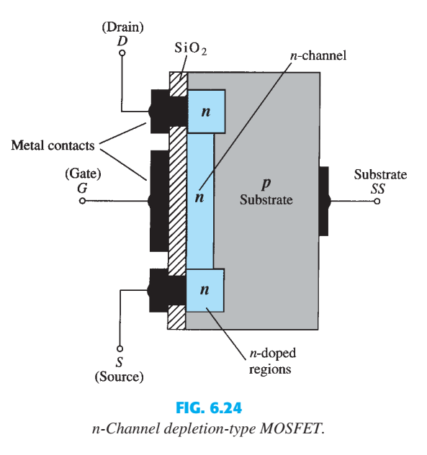
Field Effect Transistor

Slide 25
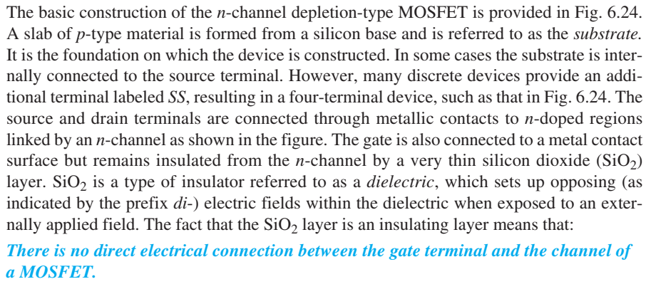
Field Effect Transistor

Slide 26
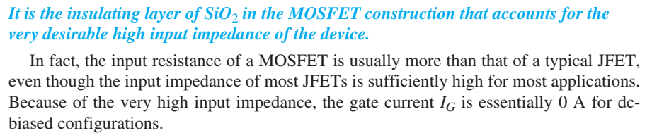
Field Effect Transistor

Slide 27

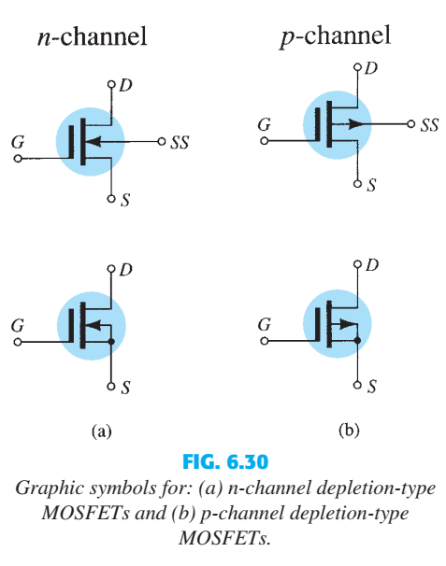
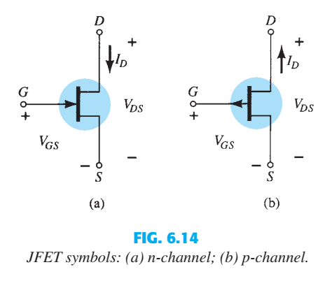
Field Effect Transistor

Slide 28
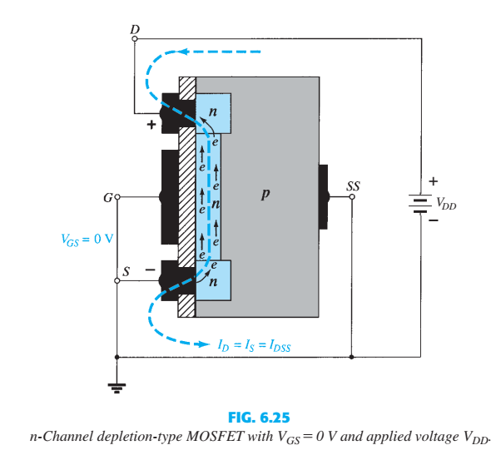
Field Effect Transistor

Slide 29
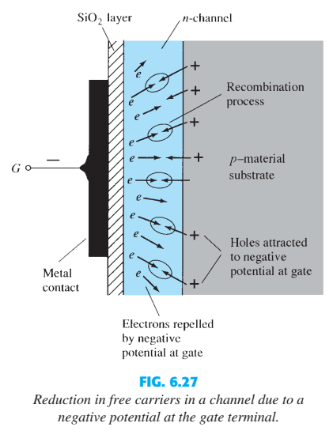
Field Effect Transistor

Slide 30
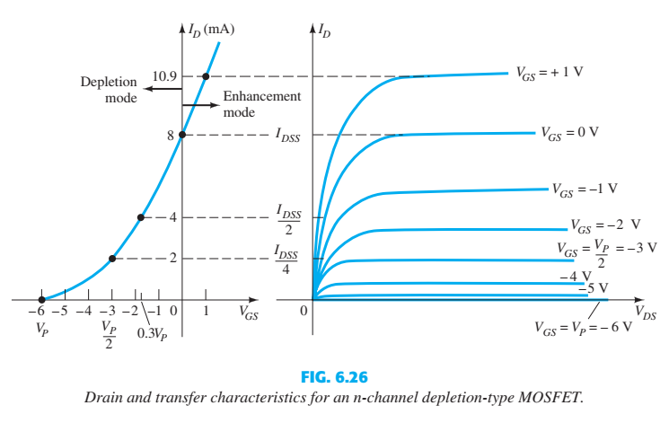
Field Effect Transistor

Slide 31
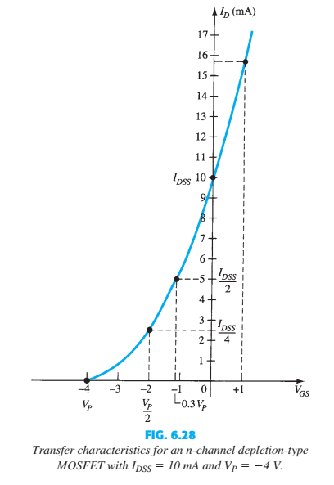
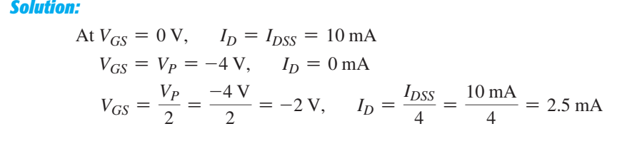
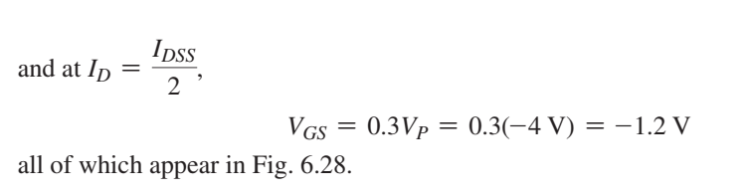
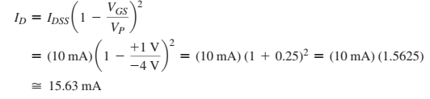
Field Effect Transistor

Slide 32

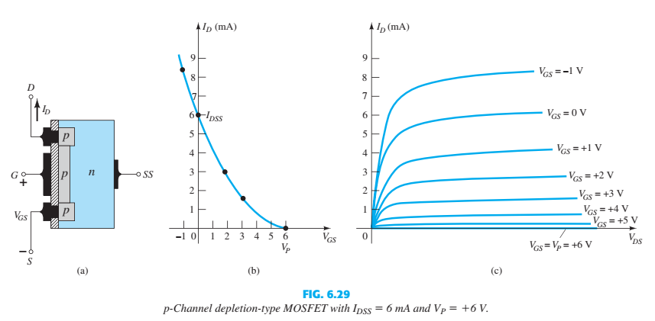
Field Effect Transistor

Slide 33
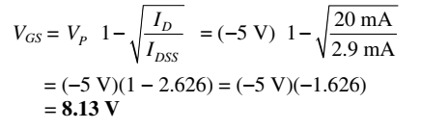
Field Effect Transistor

Slide 34

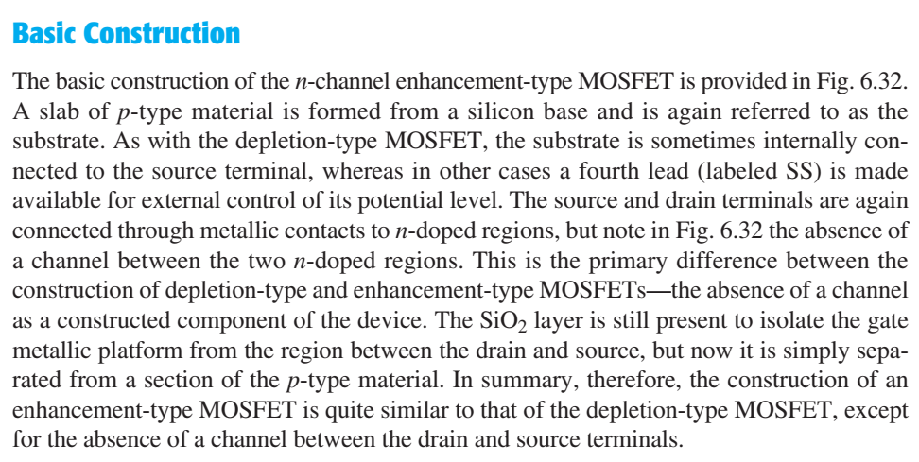
Field Effect Transistor

Slide 35
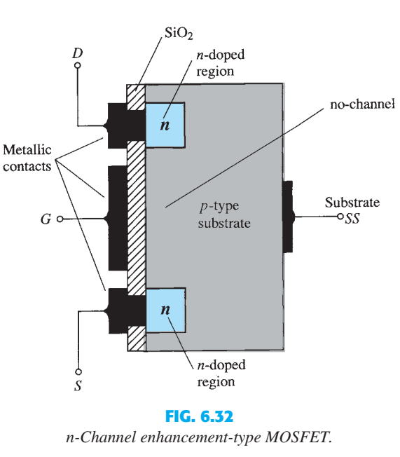
Field Effect Transistor

Slide 36


Field Effect Transistor

Slide 37
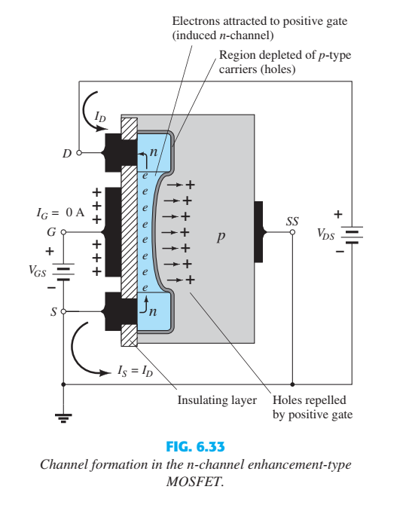
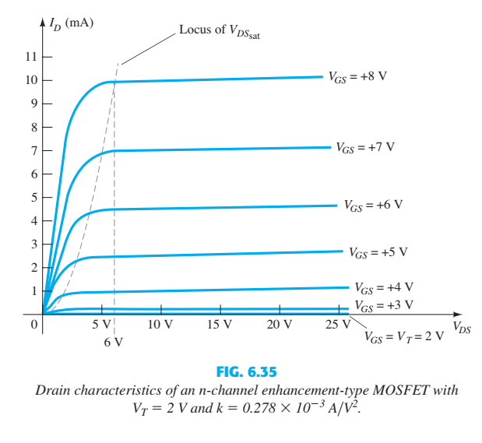
Field Effect Transistor

Slide 38

Field Effect Transistor

Slide 39
Field Effect Transistor

Slide 40


Field Effect Transistor

Slide 41


Field Effect Transistor

Slide 42

Transfer Characteristics Curve
Field Effect Transistor

Slide 43

Transfer Characteristics Curve
Field Effect Transistor

Slide 44


Transfer Characteristics Curve
Field Effect Transistor

Slide 45

Transfer Characteristics Curve
Field Effect Transistor

Slide 46

Transfer Characteristics Curve
Field Effect Transistor

Slide 47
Assignment (15 Marks)
CMOS
Field Effect Transistor

Slide 48


Field Effect Transistor

Slide 49



Field Effect Transistor

Slide 50



Field Effect Transistor

Slide 51


Field Effect Transistor

Slide 52

Field Effect Transistor

Slide 53

Field Effect Transistor

Slide 54

Field Effect Transistor

Slide 55



Field Effect Transistor

Slide 56


Field Effect Transistor

Slide 57

Field Effect Transistor

Slide 58


Field Effect Transistor

Slide 59

Field Effect Transistor

Slide 60



Field Effect Transistor

Slide 61


Field Effect Transistor

